Slide 1
C# & .NET Framework
Chapter 11: .NET Assemblies

Slide 2
Review
A delegate type maintains three important pieces of information:
The name of the method on which it makes calls
The arguments (if any) of this method
The return value (if any) of this method
Invoke(), BeginInvoke() and EndInvoke()
Generic: solve the problem of boxing – unboxing
Default keyword
Generic constrains

Slide 3
Chapter 11: Objectives
The Role of .NET Assemblies
Understanding the Format of a .NET Assembly
Building and Consuming a Single-File Assembly
Building and Consuming a Multi-file Assembly
Understanding Private Assemblies.
Understanding Shared Assemblies
Consuming a Shared Assembly

Slide 4
Role of .NET Assemblies
Assemblies Promote Code Reuse
a code library need not take a *.dll file extension.
a referenced *.exe can also be considered a “code library.”
a code library can be created in C# and reuse that library in any other .NET programming language. It is possible to not only allocate types across languages, but derive from them as well.

Slide 5
Role of .NET Assemblies
Assemblies Are Versionable Units
.NET assemblies are assigned a four-part numerical version number of the form <major>.<minor>.<build>.<revision>
This number, in conjunction with an optional public key value, allows multiple versions of the same assembly to coexist in harmony on a single machine.

Slide 6
Role of .NET Assemblies
Assemblies Are Self-Describing
Assemblies are regarded as self-describing in part because they record every external assembly it must have access to in order to function correctly.
A manifest is a metadata that describes the assembly itself (name, version, external assemblies, etc.).
In addition to manifest data, an assembly contains metadata that describes the composition (member names, implemented interfaces, base classes, constructors and so forth) of every contained type.

Slide 7
Role of .NET Assemblies
Assemblies Are Configurable
Assemblies can be deployed as “private” or “shared.”
Private assemblies reside in the same directory (or possibly a subdirectory) as the client application making use of them.
Shared assemblies, on the other hand, are libraries intended to be consumed by numerous applications on a single machine and are deployed to a specific directory termed the Global Assembly Cache (GAC).

Slide 8
Format of a .NET Assembly
A .NET assembly (*.dll or *.exe) consists of the following elements:
A Win32 file header
A CLR file header
CIL code
Type metadata
An assembly manifest
Optional embedded resources

Slide 9
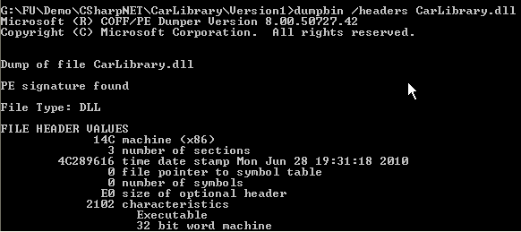
Format of a .NET Assembly
The Win32 File Header
establishes the fact that the assembly can be loaded and manipulated by the Windows.
identifies the kind of application (console-based, GUI-based, or *.dll code library) to be hosted by the Windows
Example: dumpbin /headers CarLibrary.dll

Slide 10
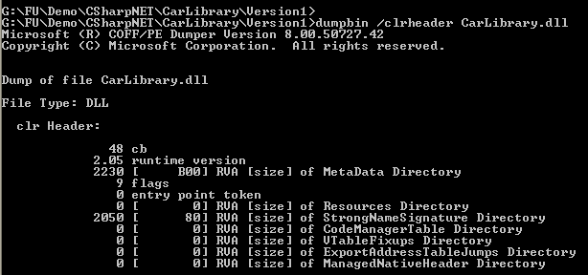
Format of a .NET Assembly
The CLR File Header
defines numerous flags that enable the runtime to understand the layout of the managed file.
For example, flags exist that identify the location of the metadata and resources within the file, and so forth
Example: dumpbin /clrheader CarLibrary.dll

Slide 11
Format of a .NET Assembly
CIL code, Type Metadata, and the Assembly Manifest
Optional Assembly Resources
a .NET assembly may contain any number of embedded resources such as application icons, image files, sound clips….
be useful if you wish to partition your resources based on a specific culture (English, German, etc.)

Slide 12
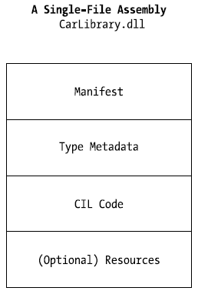
Format of a .NET Assembly
Single-File Assemblies
one-to-one correspondence between the (logical) assembly and the underlying (physical) binary
Notes:
Metadata
Metadata là thông tin được lưu trữ bên trong assembly với mục đích là để mô tả các kiểu dữ liệu, các phương thức và các thông tin khác về assembly. Do có chứa metadata nên assembly có khả năng tự môtả.
Manifest
Manifest chính là một thành phần của metadata. Manifest mô tả một assembly chứa những gì, ví dụ như: thông tin nhận dạng (tên, phiên bản), danh sách các kiểu dữ liệu, danh sách các resource, danh sách các assembly khác được assembly này tham chiếu đến ...

Slide 13
Format of a .NET Assembly
Multi-file Assemblies
A set of .NET *.dlls that are deployed and versioned as a single logic unit.
Primary module contains the assembly-level manifest (as well as any necessary CIL code, metadata, header information, and optional resources).
The modules are only logically related by information contained in the primary module’s manifest.

Slide 14
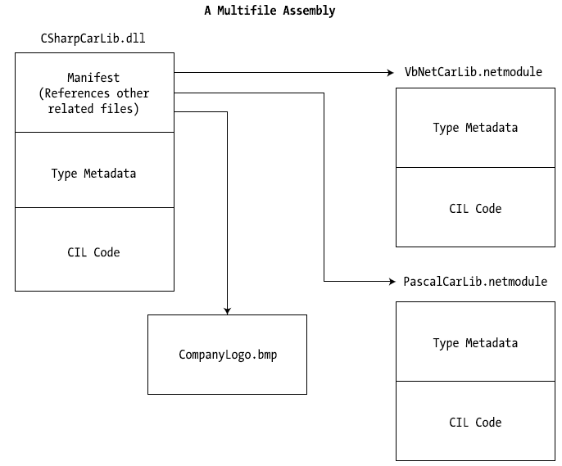
Format of a .NET Assembly
Multi-file Assembly

Slide 15
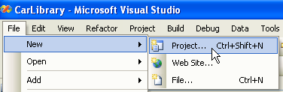
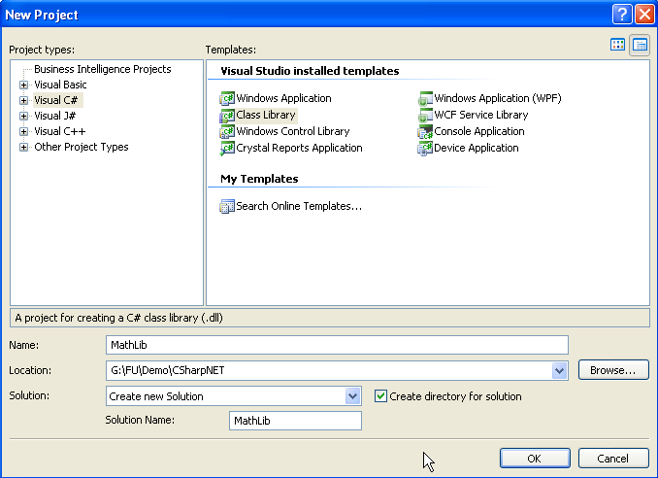
Single-File Assembly Demo
1
Build a library file: MathLib.dll
2

Slide 16
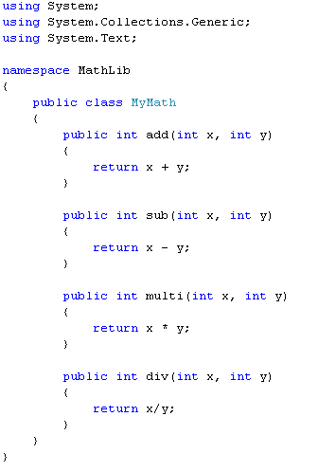
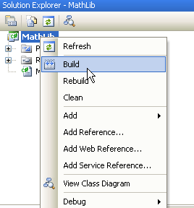
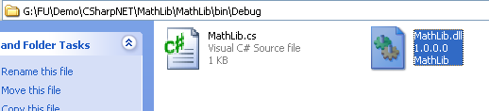
Build a library file: MathLib.dll
4
3
5

Slide 17
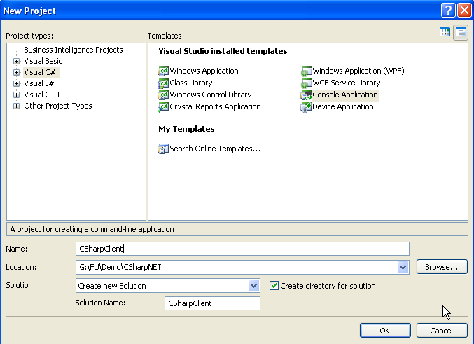
Build a C# Client Application: CSharpClient
1
2

Slide 18
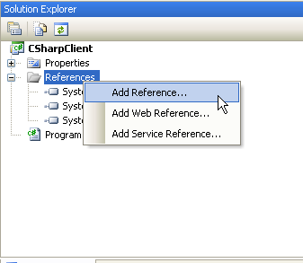
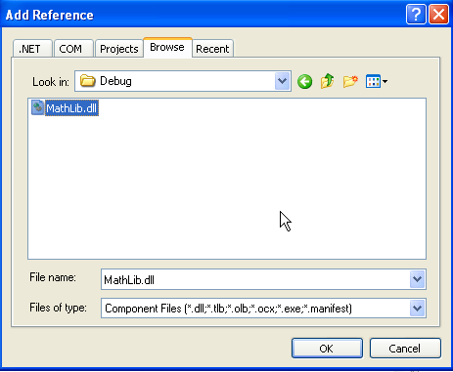
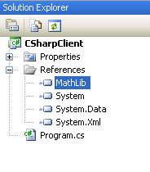
Build a C# Client Application: CSharpClient
4
3
Locate the library file created in the previous step
5

Slide 19
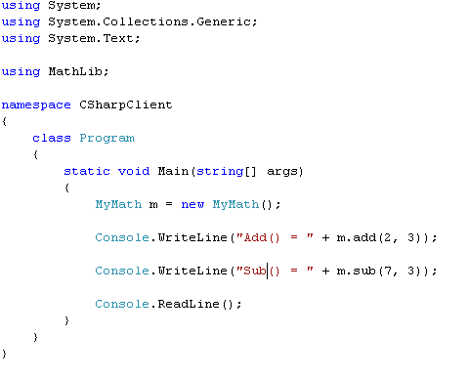
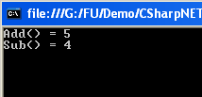
Build a C# Client Application: CSharpClient
6

Slide 20
Practice Private Assembly ( From step 1 – 5)
Lab_Private_Shared_Assemblies_C#.pdf

Slide 21
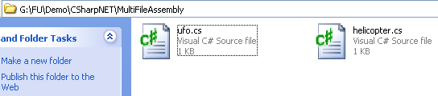
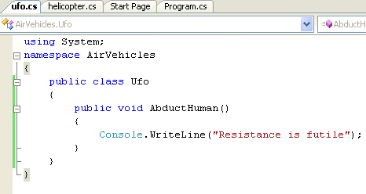
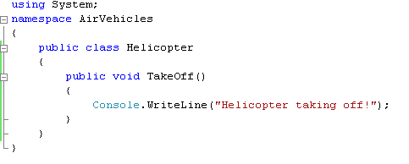
Multifile Assembly
Create multi-file library

Slide 22
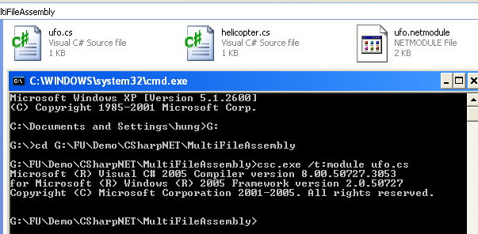
Create multi-file library
Compile assemble module:
csc.exe /t:module ufo.cs
1

Slide 23
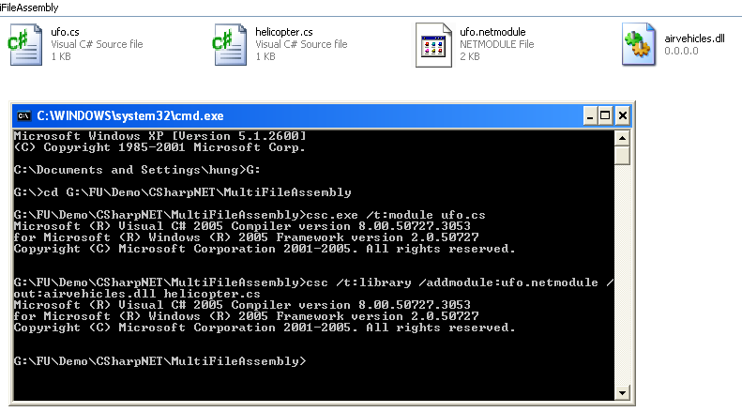
Create multi-file library
Compile and add module to primary module:
csc /t:library /addmodule:ufo.netmodule /out:airvehicles.dll helicopter.cs
2

Slide 24
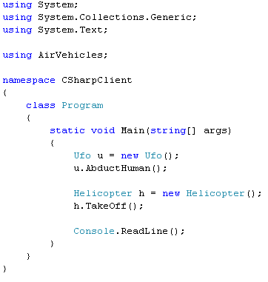
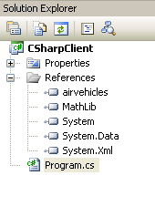

Create client application to use multi-file assembly

Slide 25
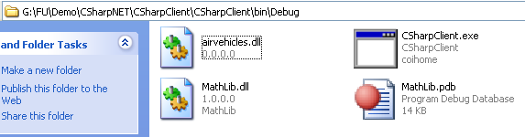
Private Assemblies
Private assemblies are required to be located within the same directory as the client application (termed the application directory) or a subdirectory thereof.
The Identity of a Private Assembly
The full identity of a private assembly consists of the friendly name and numerical version
The friendly name simply is the name of the module that contains the assembly’s manifest

Slide 26
Configuring Private Assemblies
The CLR will not probe the subdirectory to look for reference assembly unless you supply a configuration file
Configuration files must have the same name as the launching application and take a *.config file extension, and they must be deployed in the client’s application directory

Slide 27
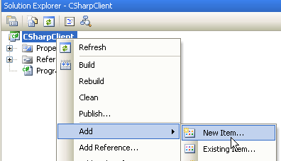
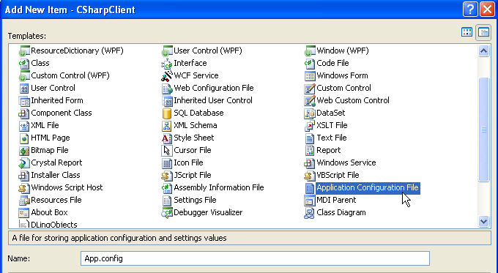
Configuring Private Assemblies
1
2
Do NOT change the name

Slide 28
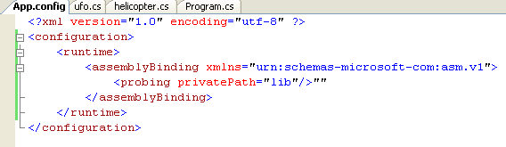
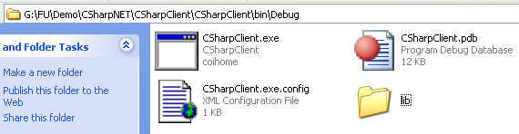

3
The privatePath attribute cannot be used to specify an absolute path
Multiple subdirectories can be assigned to the privatePath attribute using
a semicolon-delimited list
<probing privatePath="MyLibraries; MyLibraries\Tests"/>

Slide 29
Shared Assemblies
Like private assembly, a shared assembly is a collection of types and (optional) resources.
Difference between shared and private assemblies is the fact that a single copy of a shared assembly can be used by several applications on a single machine.
Shared assemblies are installed into the Global Assembly Cache (GAC) - C:\Windows\Assembly
Executable assemblies (*.exe) cannot be installed into the GAC.

Slide 30
Shared Assemblies
Understanding Strong Names
An assembly must be assigned a strong name before being deployed to GAC.
Strong name is used to uniquely identify “the publisher” of a given .NET binary.
Read more…
Notes:
//Delay Sign
sn -R myAssembly.dll sgKey.snk
//Turn off verification sn –Vr myAssembly.dll
//Password se được yêu cầu khi DelaySign
The following example turns off verification for an assembly called myAssembly.dll.
sn –Vr myAssembly.dll
To turn off verification on platforms where you can’t run the Strong Name tool, such as Advanced RISC Machine (ARM) microprocessors, use the –Vk option to create a registry file. Import the registry file into the registry on the computer where you want to turn off verification. The following example creates a registry file for myAssembly.dll.
sn –Vk myRegFile.reg myAssembly.dll

Slide 31
Shared Assemblies
A strong name is composed of a set of related data:
The friendly name of the assembly
The version number of the assembly (assigned using the [AssemblyVersion] attribute)
The public key value (assigned using the [AssemblyKeyFile] attribute)
An optional culture identity value for localization purposes (assigned using the [AssemblyCulture] attribute)
An embedded digital signature created using a hash of the assembly’s contents and the private key value
Notes:
Quy trình sử dụng chữ ký điện tử để mã hóa và giải mã thông tin
Bản thân bạn là người được cấp cho 2 khóa điện tử Public Key và Private Key như đã nêu ở trên. Bạn phải giữ gìn Private Key cẩn thận như giữ chiếc chìa khóa xe của mình. Khi có một người dùng Public Key để mã hóa một bức thư rồi gửi cho bạn, bạn phải dùng Private Key để giải mã thì mới đọc được bức thư này. Đồng nghiệp hay người thân của bạn dù có biết bức thư này cũng chịu vì không tài nào giải mã được. Dùng Private Key, cùng với một phần mềm phù hợp, bạn có thể ký tên lên một văn bản hay tập tin dữ liệu nào đó. Chữ ký điện tử này tương tự như một con tem độc nhất vô nhị dán lên văn bản, khó có thể giả mạo được. Ngoài ra, chữ ký còn đảm bảo phác giác được bất kỳ sự thay đổi nào trên dữ liệu đã được “ký”. Để ký lên một văn bản, phần mềm ký tên của bạn sẽ nghiền (crunch down) dữ liệu để “túm lại” bằng một vài dòng, được gọi là thông báo tóm tắt, bằng một tiến trình được gọi là “kỹ thuật băm” (hashing), rồi tạo thành chữ ký điện tử. Cuối cùng, phần mềm ký tên của bạn sẽ gắn chữ ký điện tử này vào văn bản. Khi bạn gửi văn bản đã ký tên này đến cho một đồng nghiệp thì anh ta dùng Public Key giải mã chữ ký ngược trở lại thành một thông báo tóm tắt để biết có phải chính bạn đã ký tên vào văn bản này hay không. Đồng thời anh ta cũng dùng phần mềm của mình tạo một thông báo tóm tắt từ dữ liệu trên văn bản và so sánh với thông báo tóm tắt do bạn tạo ra. Nếu hai thông báo tóm tắt này giống nhau tức là dữ liệu trên văn bản là toàn vẹn, không bị thay đổi bởi người khác.

Slide 32
Shared Assemblies
Step to produce strong name
Public/private key data are generated (using the .NET Framework 2.0 SDK’s sn.exe utility) into a Mykey.snk file
The compiler will record the full public key from Mykey.snk
The compiler will also generate a hash code based on the contents of the entire assembly (CIL code, metadata, and so forth)
This hash code is combined with the private key data within the Mykey.snk file to produce a digital signature

Slide 33
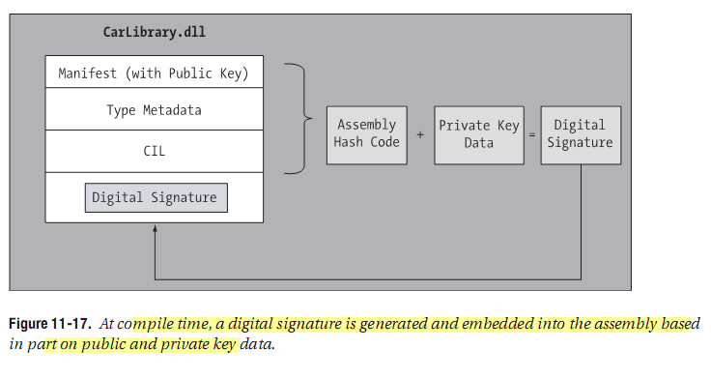
Shared Assemblies

Slide 34
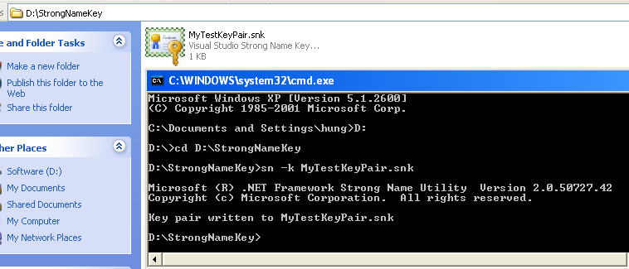
Strongly Name example
Generate public/private key:
sn -k MyTestKeyPair.snk

Slide 35
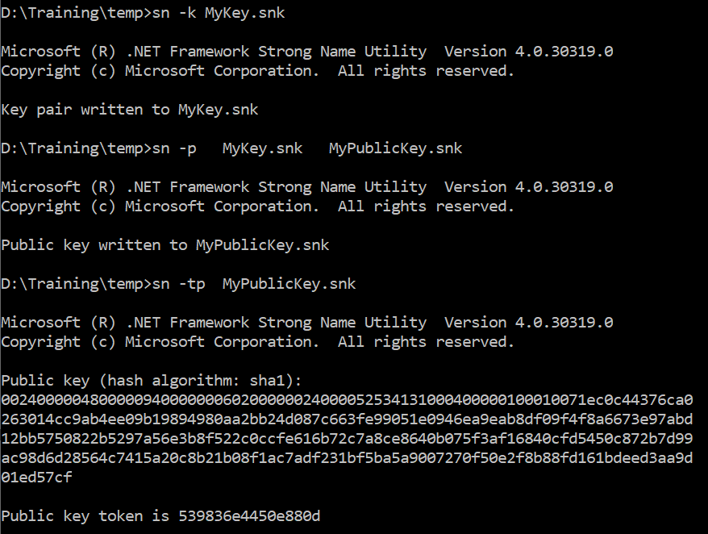
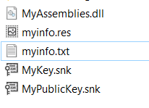

Slide 36
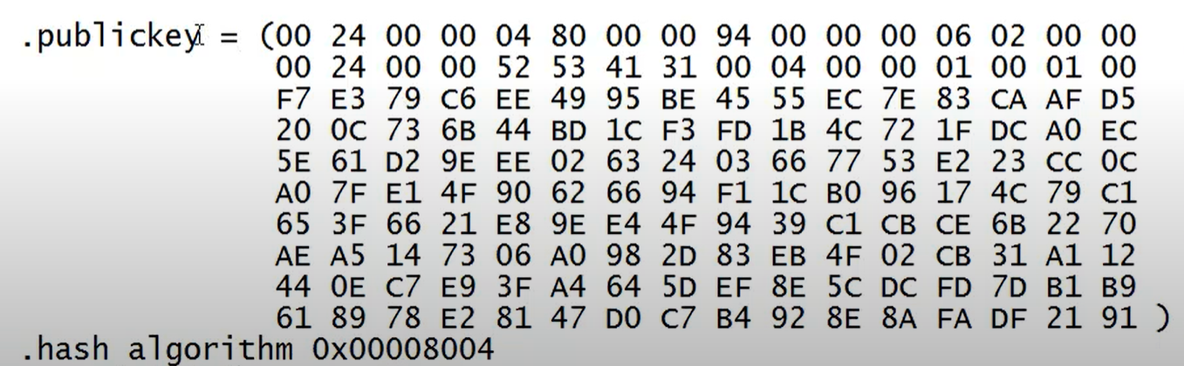
To view Public Key an assembly :
ildasm d:\myAssembly.dll
(double click on manifest )
To verify an assembly :
sn -R myAssembly.dll sgKey.snk
Notes:
ildasm /out:myfile.txt myAssembly.dll

Slide 37
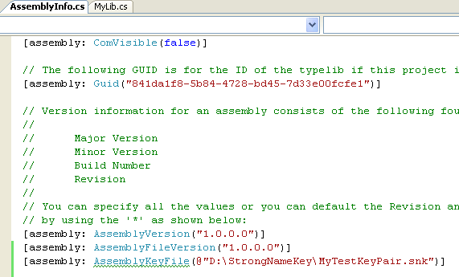
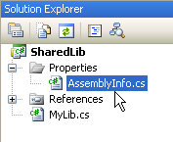
Specify key file:
[assembly: AssemblyKeyFile(@"D:\StrongNameKey\MyTestKeyPair.snk")]

Slide 38
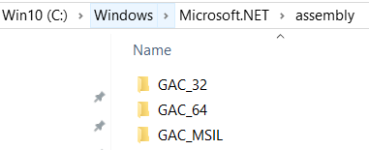
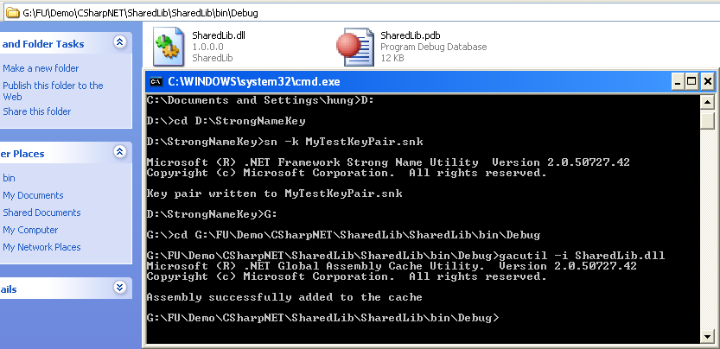
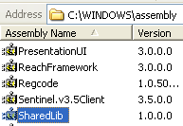
Installing/Removing Shared Assemblies to/from the GAC
Installing
gacutil /i SharedLib.dll
Change /u to remove

Slide 39
Practice Shared Assembly ( Form Step 6)
Lab_Private_Shared_Assemblies_C#.pdf

Slide 40
Consuming Share Assembly
How to consume a shared assembly? Reading more from the book…

Slide 41
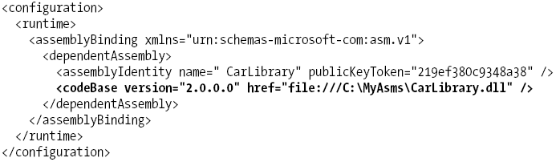
The <codeBase> Element
Used to instruct the CLR to probe for dependent assemblies located at arbitrary locations (such as network share points, or simply a local directory outside a client’s application directory).
assemblies loaded from a <codeBase> element will need to be assigned a strong name
Example: edit App.config:

Slide 42
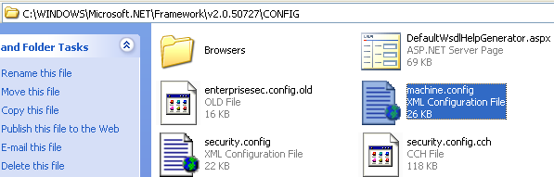
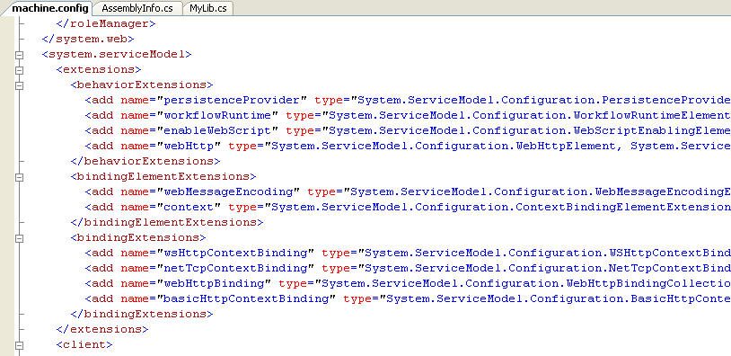
The Machine Configuration File

Slide 43
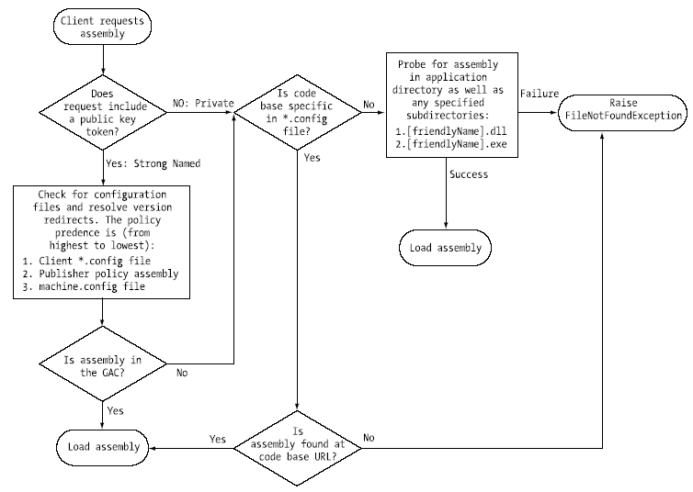
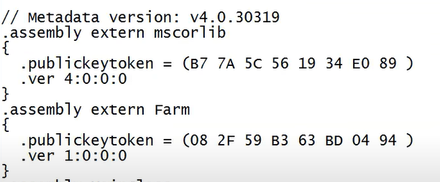
The Assembly Binding “Big Picture”

Slide 44
Lab
Build a dll assembly, call BookLib.dll that supports the following features:
Add a book to the list. Book’s details: id, name, author, publisher.
Remove a book from the list
Find a book in the list based on book name
Build a client console application that uses the BookLib.dll. A menu should be provided to allow users to select an appropriate feature: add, remove, find a book.

Slide 45
Chapter 11: Q & A

